Slide 1

The power of Processors
Data mining and ML (Machine learning) final project
By Shaked Weis

Slide 2
My research question
Is it possible to predict the amount of actions per seconds of a CPU by its parameters?
In the research we will try to predict:
the exact amount of actions per seconds with Linear regression
whether a random CPU can pass a low threshold of that amount of actions per second parameter, with Logistic regression

Slide 3


My resources
Wikipedia

Slide 4
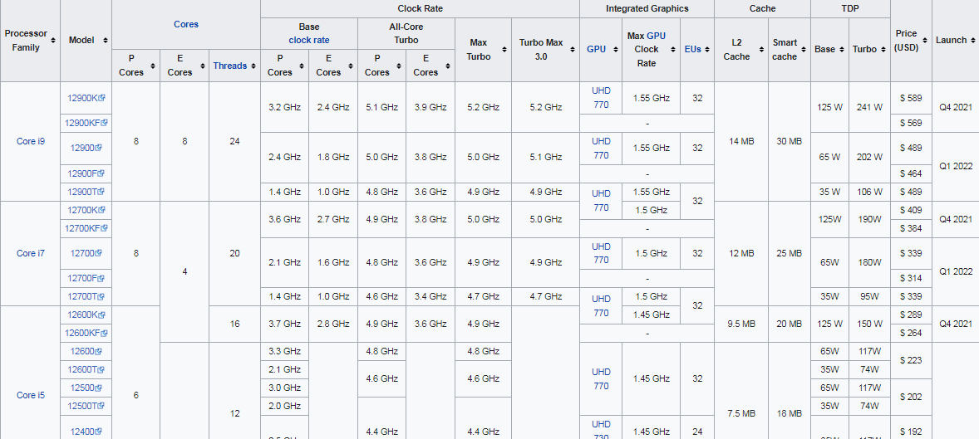
Crawling in Wikipedia
I used a built-in function from the Pandas Python library, which detects all of the tables in a webpage and save it into a list of DataFrames.

Slide 5
Data Cleaning
Merging all of the Dataframe lists into one main dataframe with pd.append
Duplicates removal
filling missing values with Average/Median values
Outliers handling

Slide 6

Data Cleaning - Merging lists of DF’s
Every wikipedia webpage crawl returns a list of all of the tables found in that page.
so we get list of tables lists!

Slide 7
Data Cleaning - Dealing with duplicates
Every wikipedia webpage crawl returns a list of all of the tables found in that page.
so we get list of tables lists
We expect for duplicates as we might crawl the same CPU model twice, because there are some pages that covers the same CPU models.
We started with 500K, and we finished with around 60K.

Slide 8
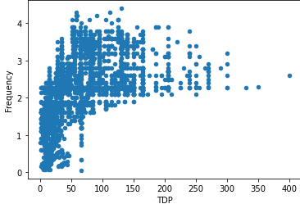
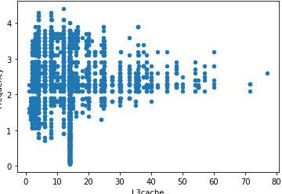
Data Cleaning - Dealing with Outliars
The outliars found are shown in graphs in the EDA section.
Because there are a lot of important information of records that filled with missing value defaults, I decided to keep those values, and locate them in the graphs, in order to improve the Models.

Slide 9
ML (Machine Learning)
My first model is a Linear regression model, which predicts the exact amount of actions per seconds of a CPU, based on its own parameters.
Sometimes Software engineerings are interested in a minimum value of actions per second, and not the exact number.
So the second model is a Logistic regression one, which predicts whether a CPU can reach and pass a minimum low threshold of actions per seconds.

Slide 10


ML (Machine Learning) - The First model
My first model is a Linear regression model, which predicts the exact amount of actions per seconds of a CPU, based on its own parameters.

Slide 11
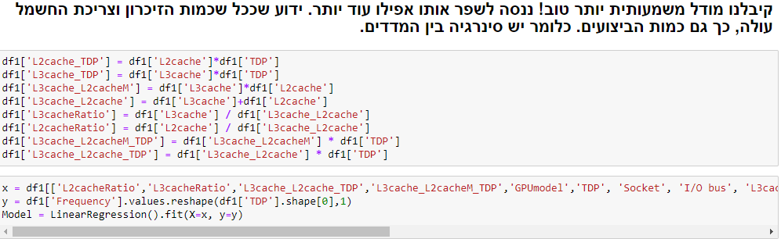

ML (Machine Learning) - The First model
My first model is a Linear regression model, which predicts the exact amount of actions per seconds of a CPU, based on its own parameters.

Slide 12
ML (Machine Learning) - The First model
My first model is a Linear regression model, which predicts the exact amount of actions per seconds of a CPU, based on its own parameters.
We managed to increase the Model’s score almost 4 times with an r2_score of 0.855!

Slide 13


ML (Machine Learning) - The Second model
Sometimes Software engineerings are interested in a minimum value of actions per second, and not the exact number.
So the second model is a Logistic regression one, which predicts whether a CPU can reach and pass a minimum low threshold of actions per seconds.

Slide 14
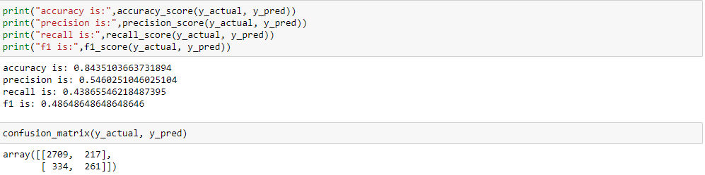
ML (Machine Learning) - The Second model
Sometimes Software engineerings are interested in a minimum value of actions per second, and not the exact number.
So the second model is a Logistic regression one, which predicts whether a CPU can reach and pass a minimum low threshold of actions per seconds.

Slide 15
ML (Machine Learning) - The Second model
We can see that when we increase the low threshold for the model, The model’s Scores will naturally decrease, as we have less records fitting the condition

Slide 16
Summary
With the models we fitted, we can predict the exact amount of actions per seconds, with an high precision score!
We can see that the amount of actions per seconds parameter is strongly connected with the TDP parameter - the amount of “heat” the CPU produce. This parameter is correlated with the CPU’s power usage, so we can say that as far as the CPU’s power usage is high, its performance will gain!

